Slide 1
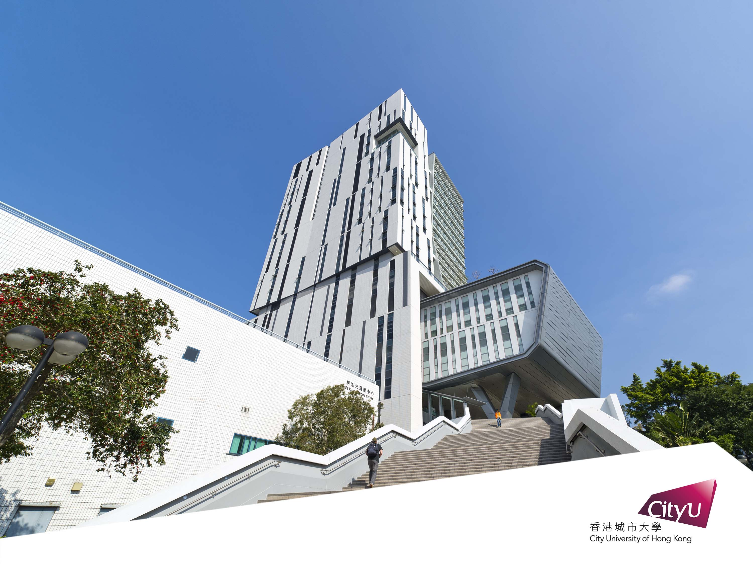

講題：人工智能應用與數學原理
Dr. Ray Cheung
Associate Professor

Slide 2
大綱內容
AI Pokemon示範
人工智能應用 - 中學生作品
人工智能的數學應用
從 K12 到大學學習機會

Slide 3




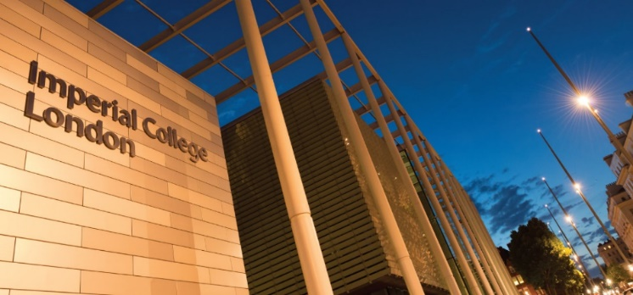



我在香港的學習之路
HKCEE
Mathematics, Additional Mathematics
Physics, Chemistry, Biology, Computer Studies
HKAL
Pure Mathematics, Applied Mathematics, Physics, Chemistry
CUHK
BEng in Computer Engineering
MPhil in Computing Science & Engineering
Imperial College London
PhD in Computing
Visiting Scholar, Stanford University
Post-Doctoral
UCLA, EEE
Research Fellow
Princeton University, EEE
CityU University of Hong Kong since 2010
Associate Professor, EE Department
CDE / ECE / IE / Microelectronics Engineering – 200+ Students per year

Slide 4


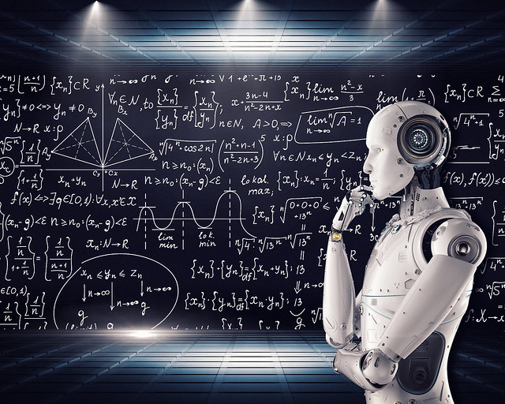


無處不在的 STEM

Slide 5

Building a Pokemon classifier with
TensorFlow, Keras and Colab

Slide 6





5 types of Pokemon to be classified
比卡超
Pikachu
小火龍
Charmander
車厘龜
Squirtle
奇異種子
Bulbasaur
超夢夢
Mewtwo

Slide 7

Which class does this image belong to?
Pikachu
Charmander
Squirtle
Bulbasaur
Mewtwo
Input image
Machine learning classifier

Slide 8
TensorFlow, Keras and Colab
TensorFlow
Open Source Machine Learning library
Keras
High Level API
Colaboratory(Colab)
Free Jupyter notebook environment with free GPU runtime
CPU: Bicycle
GPU: Car
TPU: Rocket

Slide 9
TensorFlow, Keras and Colab
Data collection
Defining your model
Model training
Model evaluation
Prediction
most of the work
few lines of code
one line
one line
one line

Slide 10
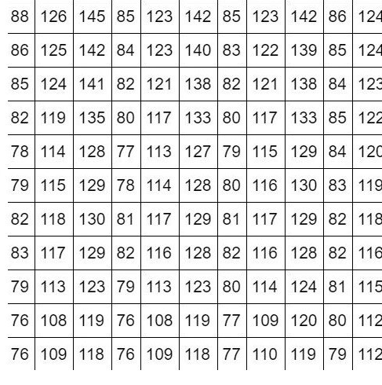
How do computers “see”?
What your computer see
What you see

Slide 11

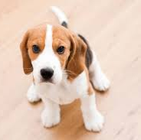
Extracting features from images
We look for lines, edges and shapes to learn the concept of a dog
These are the features we want to extract
Lines, Edges, Shapes (features)
Image
Concept of a dog

Slide 12
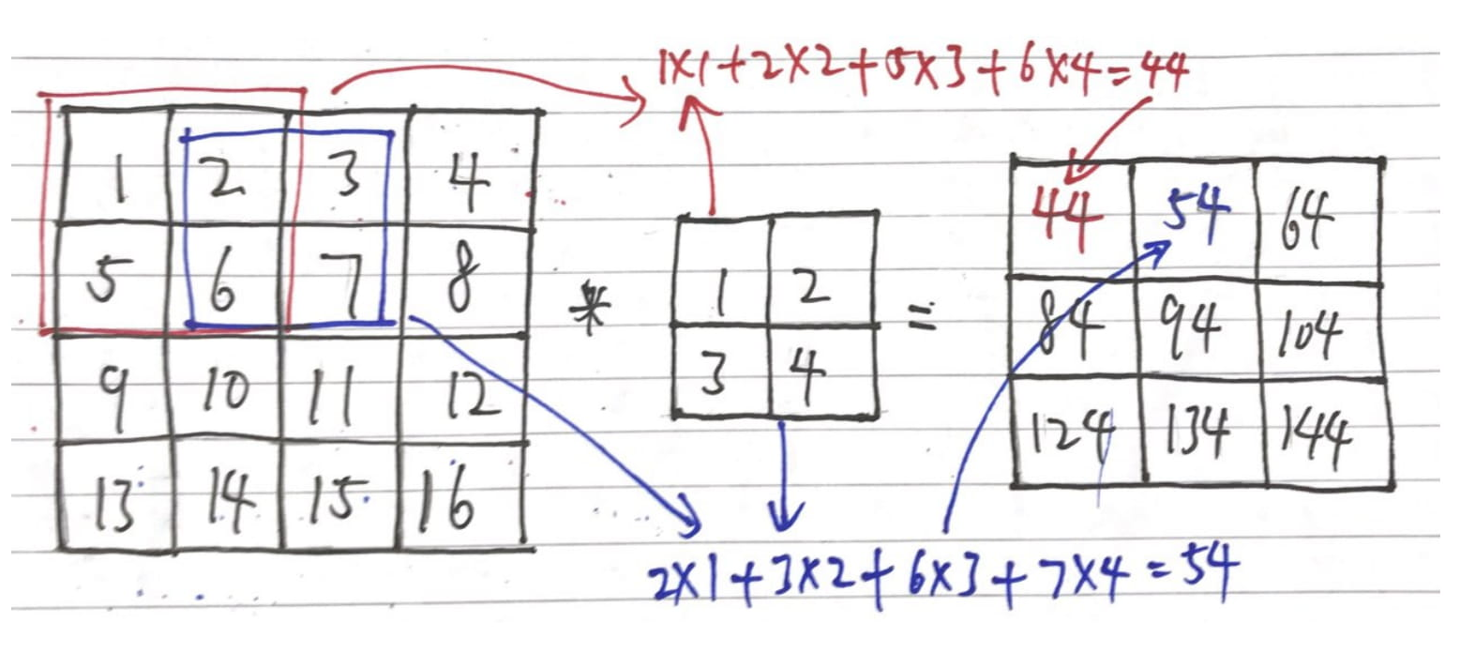
Convolution – detecting edges from images
The math operation “convolution” can be used to detect edges/extract features from an image
Image
Feature map
Filter/kernel

Slide 13
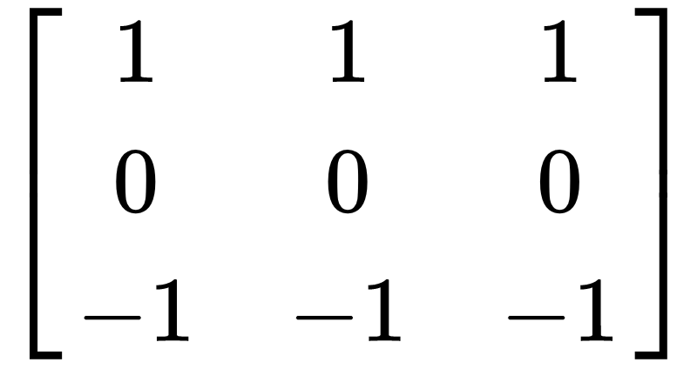
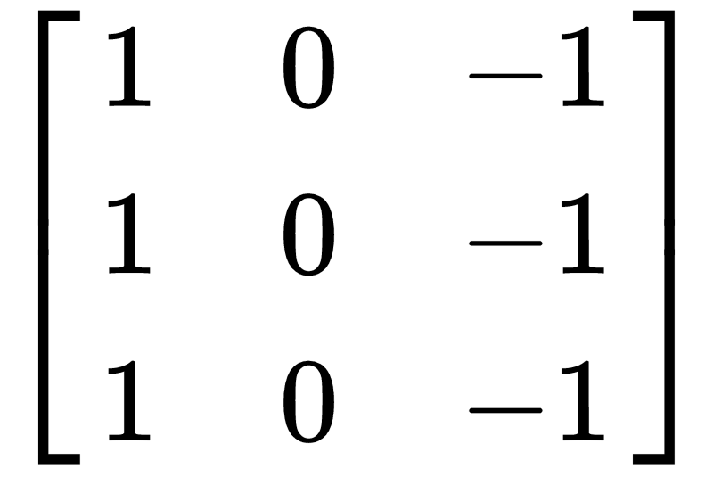
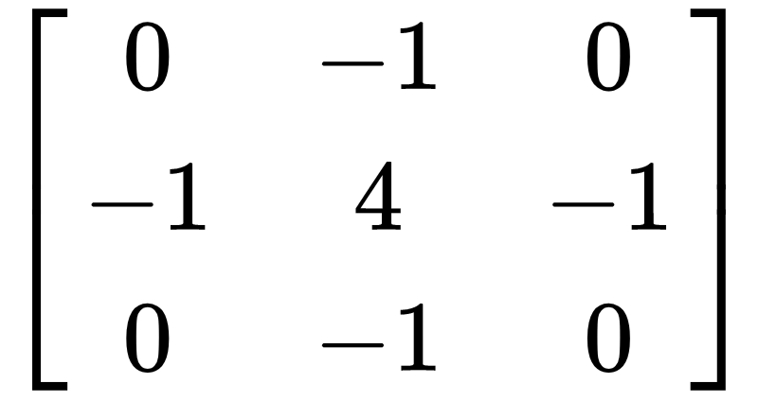
Convolution – detecting edges from images
These filters can be used to detect horizontal lines, vertical lines, and edges respectively
Horizontal line filter
Vertical line filter
Laplacian filter (edge detection)

Slide 14
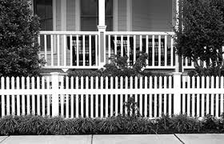
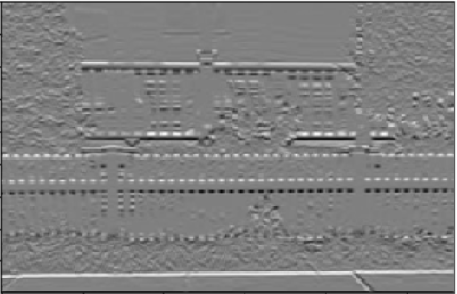
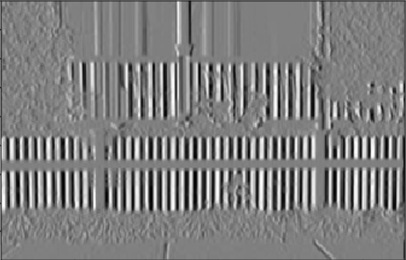
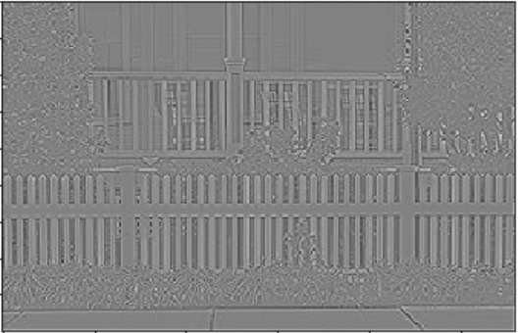
Convolution – detecting edges from images
An image after taking the convolution with…
Horizontal line filter
Laplacian filter (edge detection)
Vertical line filter

Slide 15
Now I have the features,
what’s next?

Slide 16

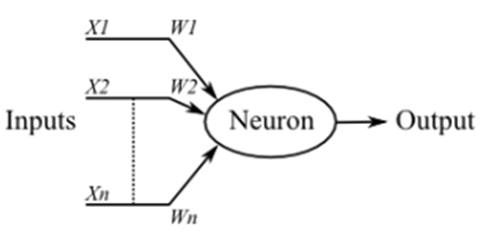
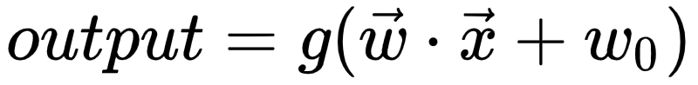
Modelling the brain – artificial neural network
A biological neuron

Slide 17
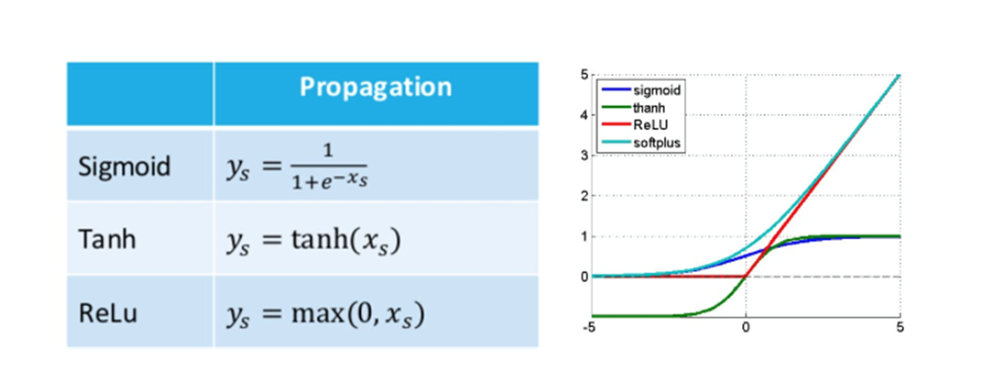
Activation Function ━ Adding Non-Linearity
Full list of common activation functions: https://keras.io/activations/

Slide 18
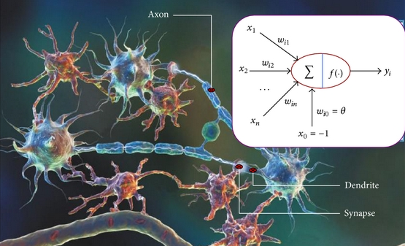
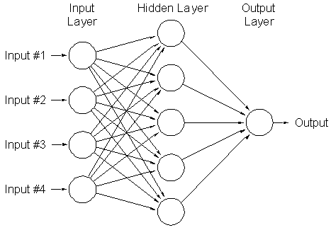
Modelling the brain – artificial neural network
Putting many neurons together, we have an artificial neural network
Aka: deep neural network, fully connected neural network, connectionist system, multilayer perceptron etc

Slide 19
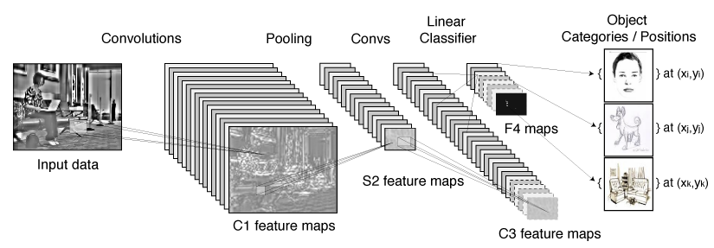
Learning the filters by convolutional neural network
Instead of handcrafting the filters, they can be learned by the convolutional neural network
Fully connected layer
Class probability
90%
5%
Feature map
5%
Feature map
Feature map

Slide 20

Hands-on coding!
https://drive.google.com/file/d/176yVWKgW02GquqAyMrTfIIcUTtycZXwF/view?usp=sharing

Slide 21
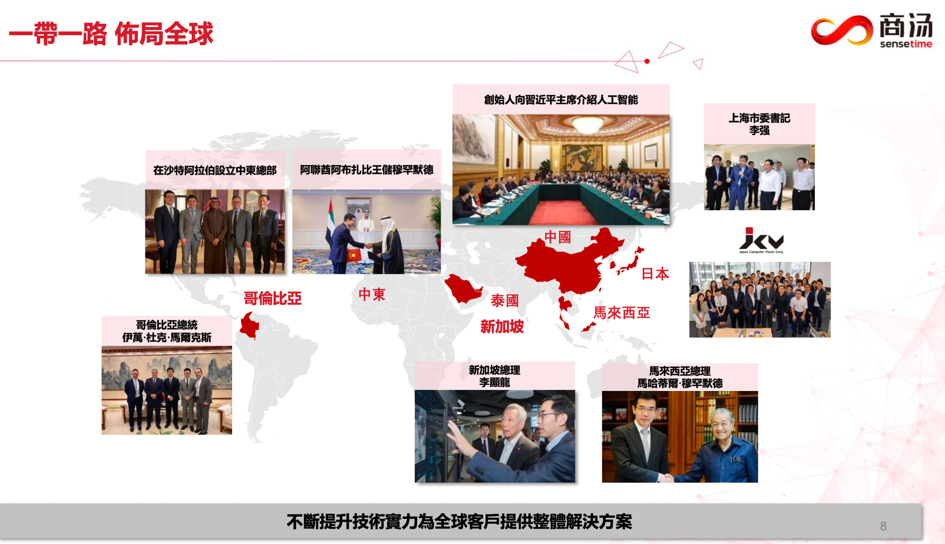
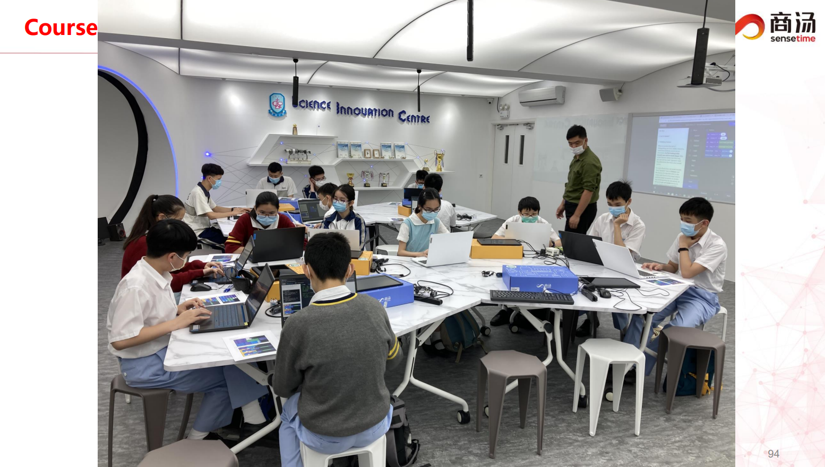
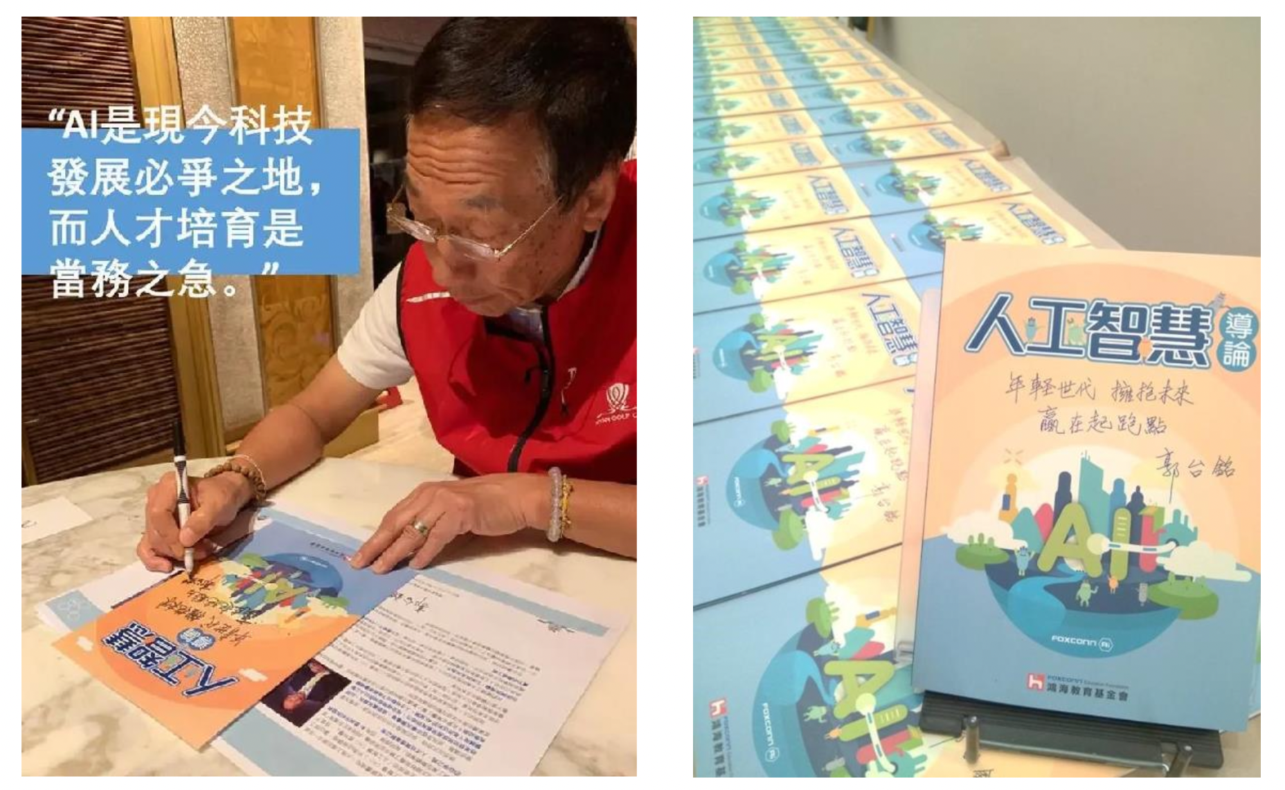
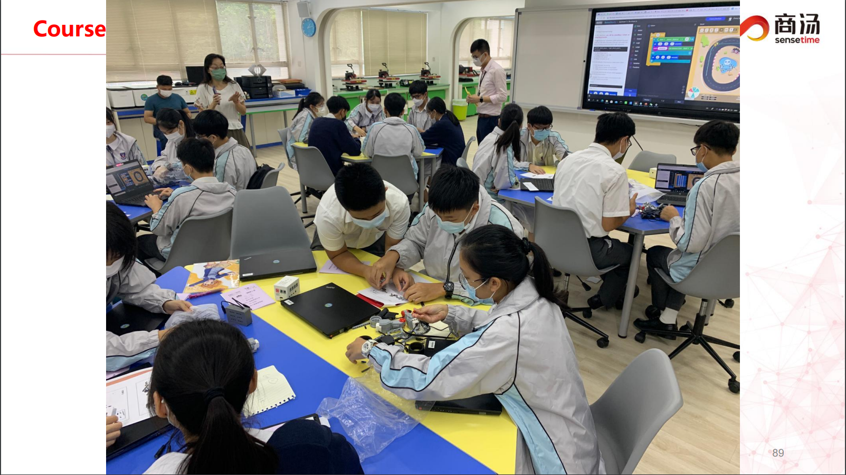
AI Education in HK

Slide 22
Many to One, One to Many
多對一，一對多
Students guided by teachers to achieve the same final goal.
Final Goal
Can Do vs. Really Understand?
可以做到與真正理解嗎？

Slide 23
Many to One, One to Many
多對一，一對多
Teachers start from here
Students have different ultimate learning outcomes
Learning how to face problems, trouble-shooting, design process, accept failure
學習如何面對問題，解決問題，設計過程，接受失敗

Slide 24
K12教育的基礎知識
Maths, Literacy, Science, Value, Learn how to learn, …
Flowchart / Abstraction / Algorithm / Data Structure / Coding
Robots / VR / AR / 3D Printing / NFT / AI / Cloud / … / Endless opportunities

Slide 25
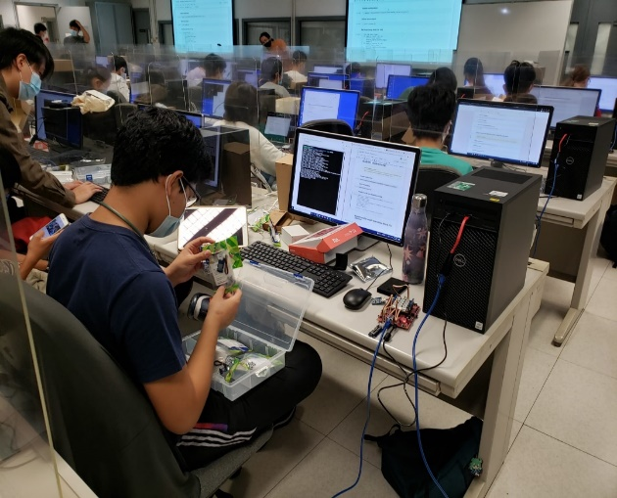
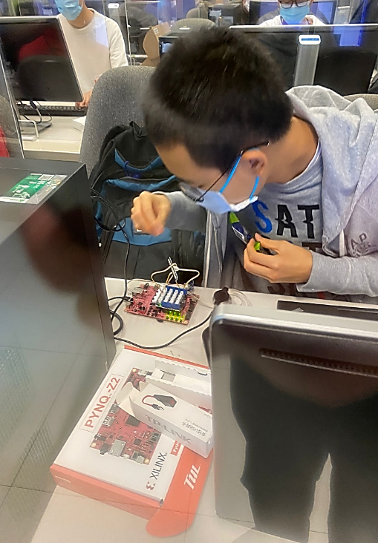
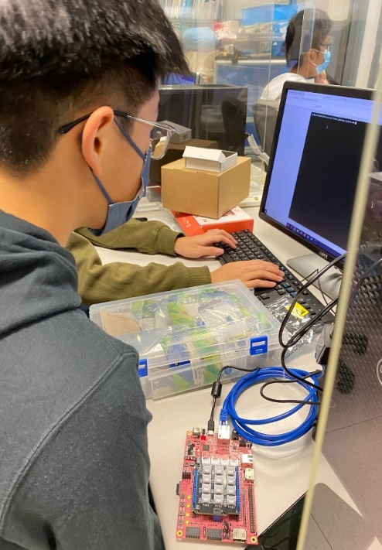
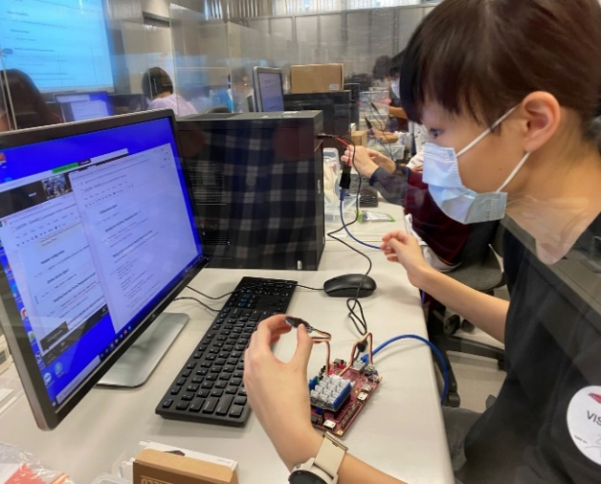
人工智能應用 - 中學生作品
GEF 2021 project exhibition page: https://cityueegef.github.io/exhibition/

Slide 26
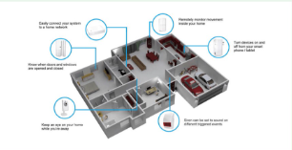
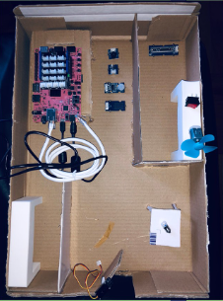
AI Care for the Elderly
Video demo: https://www.youtube.com/watch?v=wvADnTICfPQ
https://gorjoe.github.io/gef_p8_ACE/
Source code: https://github.com/gorjoe/gef_p8_ACE

Slide 27
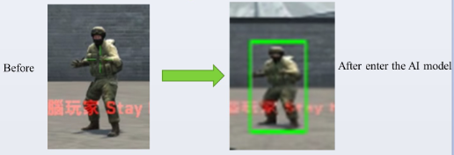
Game Character Detection
Video demo: https://www.youtube.com/watch?v=_JMfFlzSGPU
Source code: https://github.com/HellfireSam/valorant_aim_assist

Slide 28
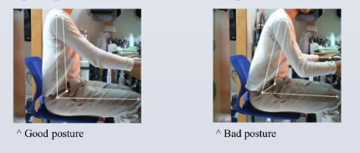
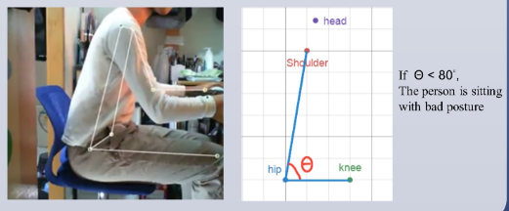
AI Posture check
Video demo: https://www.youtube.com/watch?v=V94WaBHLkEs
Source code: https://github.com/aswchlkin/PostureCheck

Slide 29
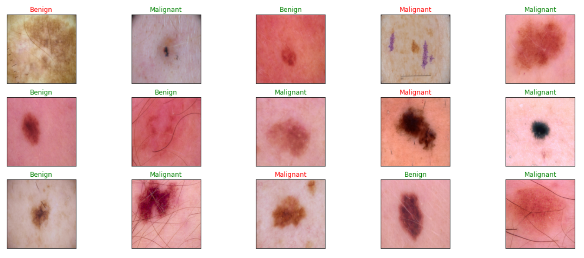
Skin Cancer Detection
Video demo: https://www.youtube.com/watch?v=TJzRMHJYSN4
Source code: https://github.com/vichubrb/P02---Spotted-Skin-Cancer-Image-Recognition

Slide 30
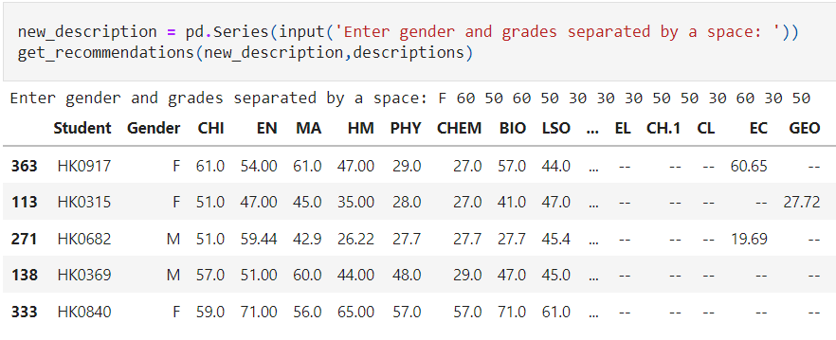
HKDSE Elective-Recommendation
Video demo: https://www.youtube.com/watch?v=4eU7Cq4BHQ0
Source code: https://github.com/aurorachua/Elective-Recommendation-System

Slide 31

Language Pronunciation Accuracy Checker
Video demo: https://www.youtube.com/watch?v=29RpBgZeJU0
Source code: https://github.com/InTheAirMC/lang_pronunciation_cityu

Slide 32
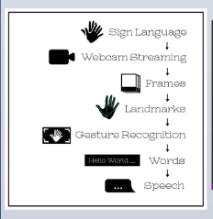
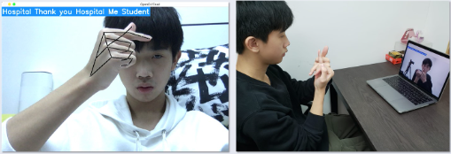
Sign Language Translator
Video demo: https://www.youtube.com/watch?v=lgsdAOW6mOg
Source code: https://github.com/LucasYam/P50_SignLanguageTranslator

Slide 33
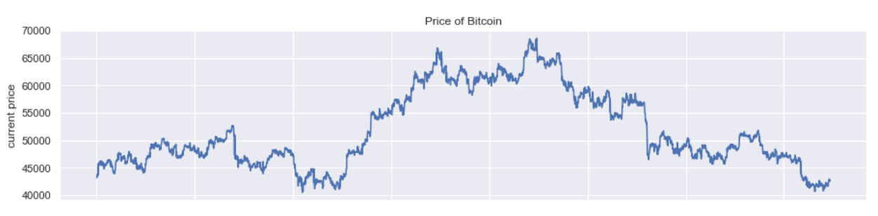
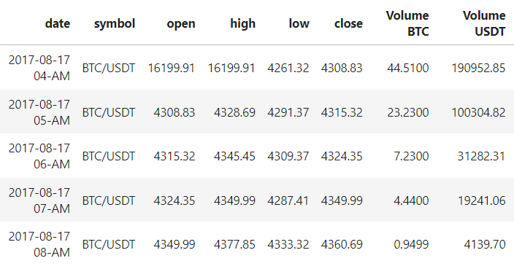
Bitcoin Price Prediction
Video demo: https://www.youtube.com/watch?v=CA3yEnpxk1w
Source code: https://github.com/Metrinox/Earning-Cryptocurrency-Using-Artificial-Intelligence-Algorithm

Slide 34
人工智能的數學應用

Slide 35
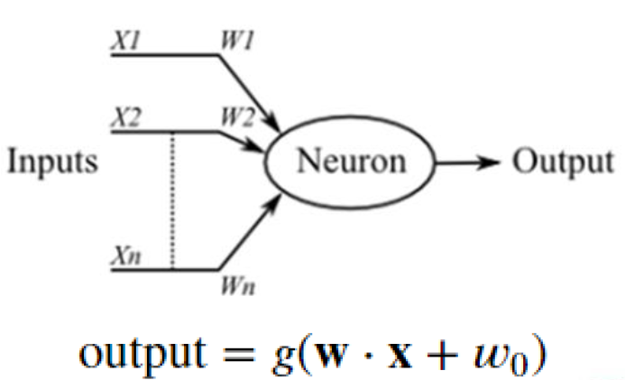
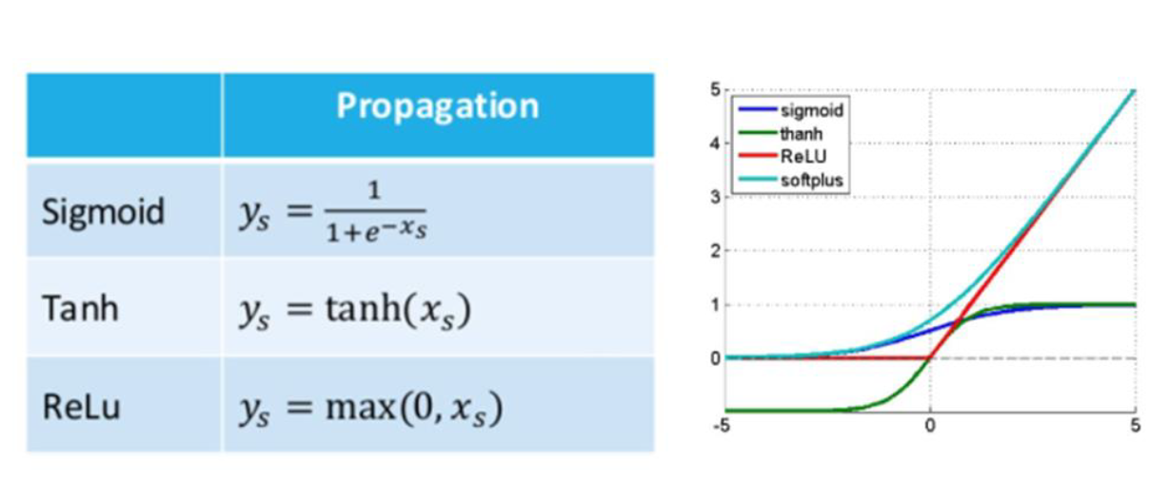
AI的數學應用 - 函數
人工神經元
激活函數 (activation function)

Slide 36
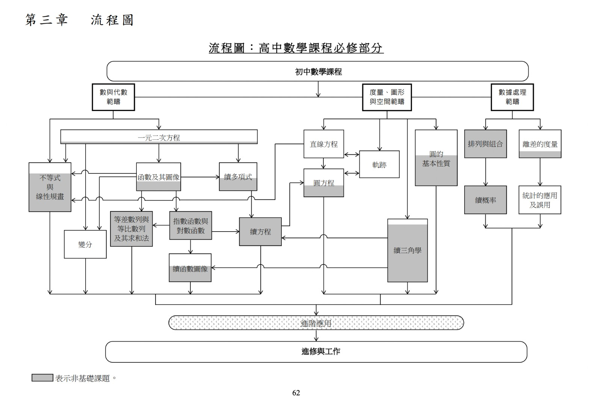
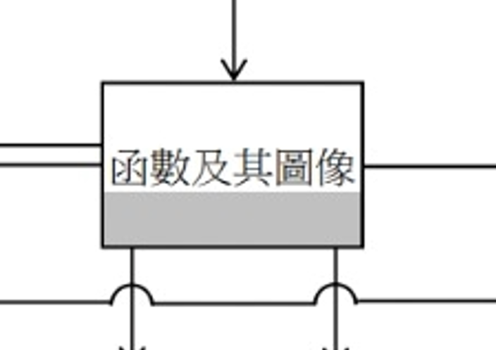

Slide 37
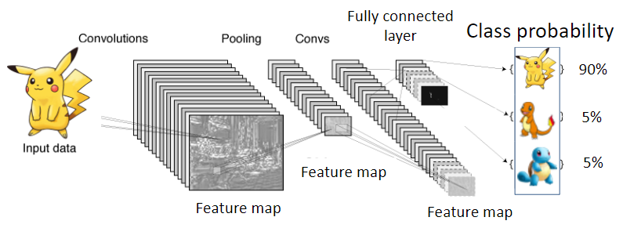


AI的數學應用 – 概率
How likely it is Pikachu?

Slide 38
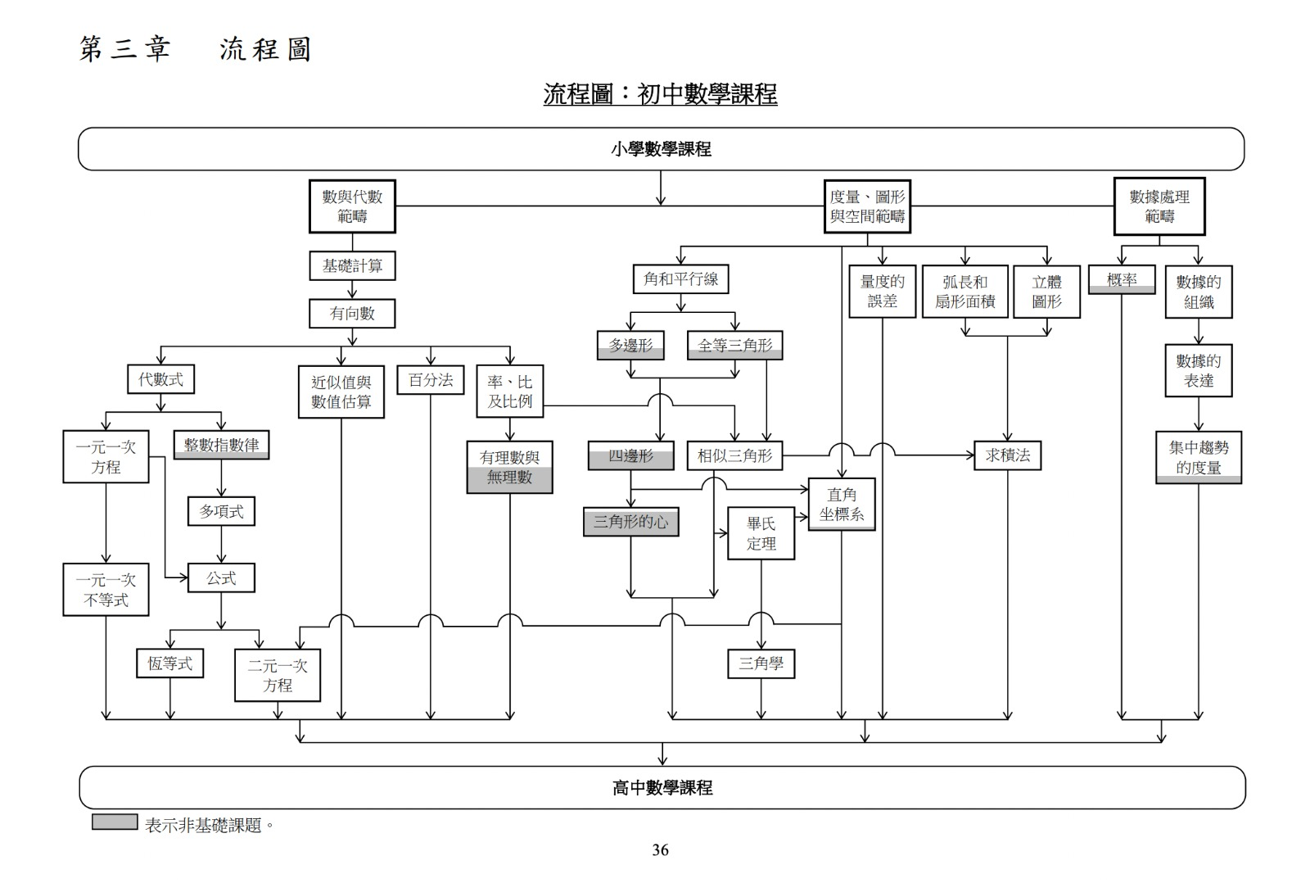
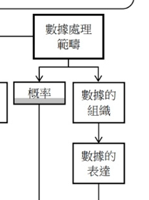

Slide 39
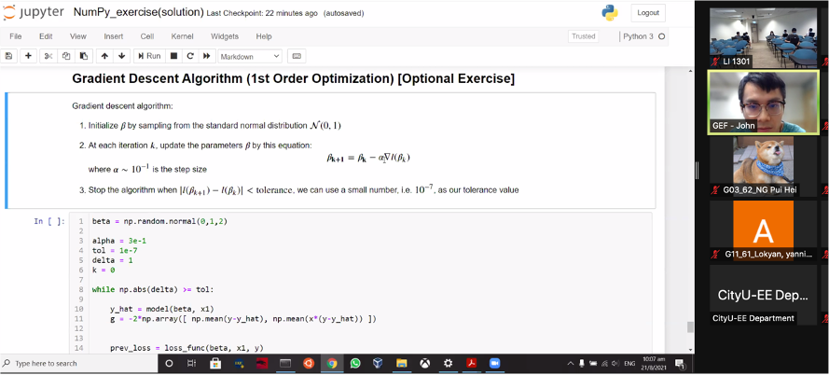
AI的數學應用 -微積分
機器學習 = 損失函數(loss function)最少化
優化問題 -> 微積分

Slide 40
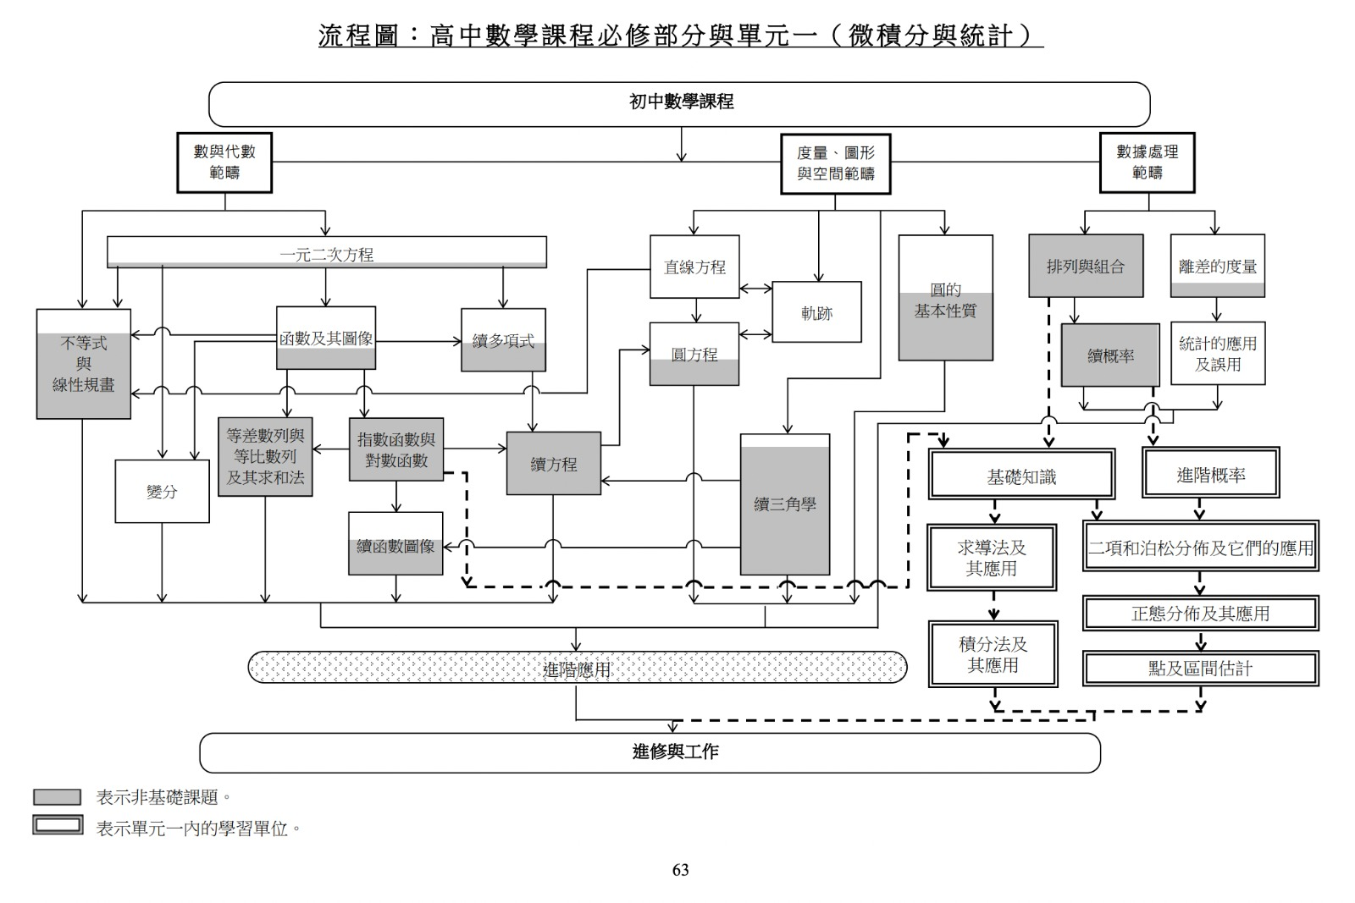
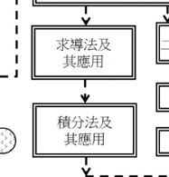

Slide 41
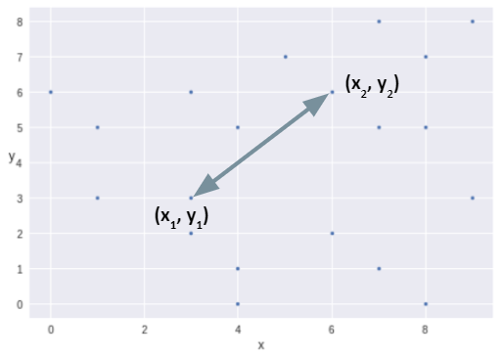
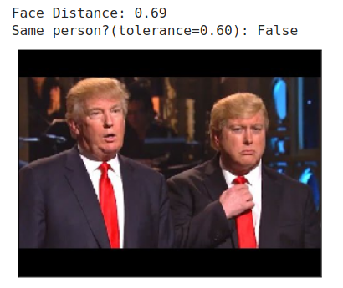

AI的數學應用 – 距離計算
人面識別 = 距離計算 (face distance)
歐幾里得距離 (Euclidean distance)

Slide 42


Slide 43

AI的數學應用 – 卷積
An image after taking the convolution with…
Horizontal line filter
Laplacian filter (edge detection)
Vertical line filter

Slide 44


AI的數學應用 - 張量計算
Multidimensional data
High-order tensor formulations
Example 1: Gene × Condition × Time
Example 2: Document × Key word × Region
Example 3: Speech × Frequency× Time
Reference: http://callcenterinfo.tmcnet.com/analysis/articles/
156051-what-att-purchase-t-mobile-means.htm

Slide 45



Slide 46



人手運算 vs 電腦運算
1個變數 vs ~10萬個變數

Slide 47

AI運算 - FPGA硬件加速
~15x speed up compared with GPU (FP32)
~250x speed up compared with CPU (FP32)
https://github.com/cityueegef/gef2020_aiot_exercise_notebooks/tree/main/vitis_ai_pynq_dpu/comparison

Slide 48

AIoT Coding, Engineering and Entrepreneurial (AIoT CE2) Skills Education for Gifted Students Programme
硬件編程
軟件編程

Slide 49



以學習AI提升學生對數學興趣

Slide 50




以學習AI提升學生對數學興趣

Slide 51


University Intern Example
Starting learning AI since Form 3
Self-learning Python and Deep learning Framework
Summer Internship at CityU Apps Lab
https://github.com/chinglamchoi/Corona-Net

Slide 52
Further Reading & Resources

Slide 53


Slide 54


Slide 55


https://www.khanacademy.org/math/geometry/hs-geo-similarity/hs-geo-similar-and-congruent-triangles-modeling/v/golden-ratio-to-find-radius-of-moon

Slide 56







Slide 57
Technology
Language Subjects
Language Subjects
Language
Language
Computing

Slide 58


National curriculum in England: framework for key stages 1 - 4
Computing is a core subject in all 4 stages.
https://www.gov.uk/government/publications/national-curriculum-in-england-framework-for-key-stages-1-to-4/the-national-curriculum-in-england-framework-for-key-stages-1-to-4

Slide 59

From Thinking to Writing
https://www.cs.tau.ac.il/~nachumd/term/FloydMeaning.pdf
Assigning Meanings to Programs (1960)
From Set Theory
Mathematical statements
Flowchart
computer statements
Computer Execution

Slide 60



https://www.apple.com/education/docs/everyone-can-code-curriculum-guide.pdf

Slide 61




https://student.hk/

Slide 62

https://www.ee.cityu.edu.hk/home/docs/EE-brochure-2021.pdf

Slide 63


https://www.ee.cityu.edu.hk/prospective_students/undergraduate_admission/admission_information
https://www.jupas.edu.hk/en/page/detail/3667/

Slide 64

CityU EE Course: AIoT
EE2004 - Microcomputer Systems
EE2005 - Electronic Devices and Circuits
EE2009 - Data Communications and Networking
EE3220 – System-on-Chip Design
EE3070 – Design Project

Slide 65


Our Program
JS1205 Department of Electrical Engineering
Options:
BEng Computer and Data Engineering
(電子計算機及數據工程學工學士)
BEng in Electronic and Electrical Engineering
(電子及電機工程學工學士)
BEng Information Engineering
(資訊工程學工學士 )
BEng in Microelectronics Engineering
(微電子工程學工學士)
Common first year
Students will enter a major after one year of study
Notes:
*155 First-year-first-degree places for 2021 admission including ASI. Proposed to admit up to 33.5% of non-JUPAS students (i.e. 52 first year + ASI). ASII (senior intake) places: approx. 53.

Slide 66

Acknowledgements:
Invitation from Education Bureau, HKSAR
All the Principals & Teachers attended the sharing today
CityU EE Department, John Wong, GEF Team
EDB Gifted Education Fund, 100 Gifted Student members

